Slide 1
METABOLIC SYNDROME
Dr. Kauser Usman (MD)
Associate Professor
Department of Medicine
King George’s Medical University, Lucknow

Slide 2
International Diabetes Federation Definition:
Abdominal obesity plus two other components: elevated BP, low HDL, elevated TG, or impaired fasting glucose

Slide 3
Definition
Constellation of metabolic abnormalities that confer increased risk of cardiovascular disease(CVD) and diabetes mellitus.

Slide 4
Alternative names
Metabolic syndrome
Syndrome X
Insulin resistance syndrome
Deadly quartet
Reaven’s syndrome

Slide 5
The major features of metabolic syndrome include
Central obesity
Hypertrilgyceridemia
Low high density lipoprotein (HDL)
Hyperglycemia
hypertension

Slide 6
EPIDEMIOLOGY
Prevalence increases with age
Greater industrialization and urbanization
Increase in waist circumference is found predominantly in women.
Fasting TG>150 mg/dl and hypertension more likely in men.

Slide 7
Risk factors
Overweight/ obesity- central (key feature)
Sedentary lifestyle
Predictor of CVd events and associted mortality
Associated with central obesity, TG’s, HDL, BP, glucose intolerance
Aging- prevalence increases with age
Diabetes mellitus- approx. 75% of T2DM or IGT have metabolic syndrome
Coronary heart disease- 50% of CHD patients have metabolic syndrome
About 1/3^{rd of} MS patients have premature CAD
Lipodystrophy- both genetic or acquired have severe insulin resistance

Slide 8
CLINICAL FEATURES
Usually asymptomatic and a high index of suspicion is needed for diagnosis
Examination -
Increased waist circumference
Increased Blood Pressure
Lipoatrophy
Acanthosis nigricans/ skin tags
Should alert to search for other abnormalities

Slide 10
Other associated conditions
Cardiovascular disease
increased risk for new onset CVD, ischemic stroke, PVD
Type 2 diabetes mellitus
increased risk by 3-5 folds
NAFLD and/or NASH
Hyperuricemia
PCOS- prevalence 40-50%
OSA- commonly associated with obesity, HTN & insulin resistance (CPAP improves insulin sensitivity)

Slide 11
Notes:
In addition to type 2 diabetes, insulin resistance is associated with the development of a broad spectrum of clinical conditions. These include hypertension, atherosclerosis, dyslipidemia, decreased fibrinolytic activity, impaired glucose tolerance, acanthosis nigricans, hyperuricemia, polycystic ovary disease, and obesity.
Adapted from Consensus Development Conference of the
American Diabetes Association. Diabetes Care. 1998;21:310-314.

Slide 12
IDF criteria
Waist circumference: ≥90 in males ≥80 in females
Plus two or more of the following
Hypertriglyceridemia: ≥150 TG’s or specific medication
Low HDL cholesterol: <40(M) and <50(F) or specific medication
Hypertension: blood pressure ≥130 mm systolic or ≥85 mm diastolic or specific medication
Fasting plasma glucose: ≥100 mg/dl or specific medication or previously diagnosed T2DM

Slide 13
IDF criteria
Risk Factor
Defining Level
Abdominal obesity† (Waist circumference‡)
Men Women
>90 cm >80 cm
TG
≥150 mg/dL or Rx for ↑ TG
HDL-C
Men Women
<40 mg/dL <50 mg/dL or Rx for ↓ HDL
Blood pressure
≥130/≥85 mm Hg or on HTN Rx
Fasting glucose
≥100 mg/dL or Rx for ↑ glucose
*Diagnosis is established when ≥3 of these risk factors are present.
†Abdominal obesity is more highly correlated with metabolic risk factors than is ↑BMI. ‡Some men develop metabolic risk factors when circumference is only marginally increased.
Notes:
Expert Panel on Detection, Evaluation, and Treatment of High Blood Cholesterol in Adults. JAMA. 2001;285:2486-2497; Updated AHA/NHLBI Statement Oct 18, 2005: Grundy et al. Circulation 2005; 112 (epub).

Slide 14
IDF criteria contd…
Waist circumference | Country / Ethnic group
94 cm 80 cm | Male Female | Europids* In the USA, the ATP III values ( 102 cm male; 88 cm female) are likely to continue to be used for clinical purposes
90 cm 80 cm | Male Female | South Asians Based on a Chinese , Malay and Asian-Indian population
90 cm 80 cm | Male Female | Chinese
90 cm 80 cm | Male Female | Japanese**
Use South Asian recommendations until more specific data are available |  | Ethnic South and Central Americans
Use European data until more specific data are available |  | Sub-Saharan Africans
Use South Asian recommendations until more specific data are available |  | EMME ( Arab) populations
Notes:
According to the International Diabetes Foundation (IDF) definition of the metabolic syndrome, central obesity (defined by waist circumference) is an essential component for diagnosis of the syndrome. The IDF definition recognizes ethnic-specific values for waist circumference, as shown on this slide. The IDF consensus group acknowledged that these are pragmatic cut-points taken from various different data sources, and that better data will be needed to link these to risk.
The IDF points out that although a higher cut-point is currently used for all ethnic groups in the United States for clinical diagnosis, it is strongly recommended that for epidemiological studies and, wherever possible, for case detection, ethnic group-specific cut-points should be used for people of the same ethnic group wherever they are found. Thus the criteria recommended for Japan would also be used in expatriate Japanese communities, as would those for South Asian males and females regardless of place and country of residence.
International Diabetes Federation. The IDF consensus worldwide definition of the metabolic syndrome. 2005.
Tan CE, Ma S, Wai D, et al. Can we apply the National Cholesterol Education Program Adult Treatment Panel definition of the metabolic syndrome to Asians? Diabetes Care. 2004;27:1182-1186.

Slide 15
IDF criteria contd…
Notes:
To measure waist circumference, 1) locate the upper hip bone and the top of the right iliac crest, 2) place the measuring tape in a horizontal plane around the abdomen at the iliac crest, 3) ensure that the tape is snug but does not compress the skin, 4) the tape should be parallel to floor, and 5) record the measurement at the end of a normal expiration.
Men are at increased relative risk if they have a waist circumference greater than 40 inches (102 cm); women are at an increased relative risk if they have a waist circumference greater than 35 inches (88 cm).
There are ethnic- and age-related differences in body fat distribution that may affect the predictive validity of waist circumference as a surrogate for abdominal fat.
Heterogeneity of composition of abdominal tissues, in particular adipose tissue and skeletal muscle, and their location-specific and changing relations with metabolic factors and CV risk factors in different ethnic groups do not allow a simple definition of abdominal obesity that could be applied uniformly. In particular, Asians appear to have higher morbidity at lower cutoff points for waist circumference than do white Caucasians.
National Institutes of Health, National Heart, Lung, and Blood Institute, NHLBI Obesity Education Initiative, North American Association for the Study of Obesity. The practical guide to the identification, evaluation, and treatment of overweight and obesity in adults. NIH Publication Number 00-4084. October 2000.
Misra A, Wasir JS, Vikram NK. Waist circumference criteria for the diagnosis of abdominal obesity are not applicable uniformly to all populations and ethnic groups. Nutrition. 2005;21:969-976.

Slide 16
Pathogenesis
Insulin resistance
Increased waist circumference
Dyslipidemia
Glucose intolerance
Hypertension
Decreased adiponectin levels

Slide 17
Pathogenesis contd…
Central obesity is the keystone for pathogenesis of “METABOLIC SYNDROME”
Central obesity leads to insulin resistance.
Various factors that play a role in pathogenesis includes:
IL-1, IL-6, IL-18
Resistin
TNF-alpha
CRP
Adiponectin an anti inflammatory cytokine is reduced in metabolic syndrome.

Slide 18
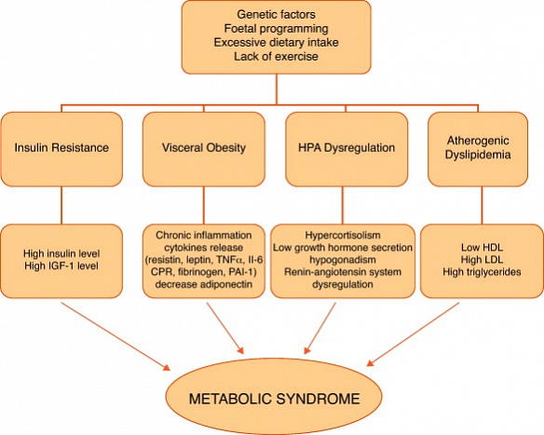
Pathogenesis contd…

Slide 19
Pathogenesis contd…
Insulin resistance
pp/fasting hyperinsulinemia
Lipolysis by LPL
Abundance of FFA’s
Impaired insulin mediated glucose uptake
Toxic injury to pancreatic islets
Increased insulin resistance
Hyperglycemia
Type 2 DM

Slide 20
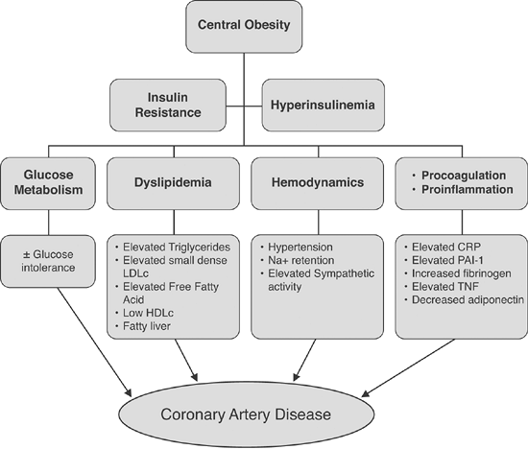
Pathogenesis contd…

Slide 21
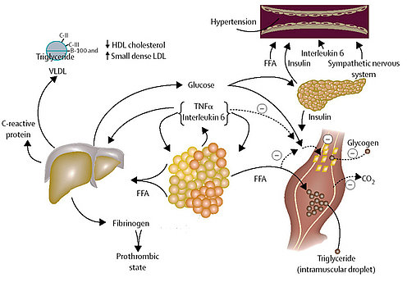
Pathogenesis contd…

Slide 22
How to diagnose?
IDF criteria
H/o symptoms of OSA in all patients
H/o PCOS in premenopausal women
Family H/o CVD and DM
Waist circumference and BP measurement
Laboratory investigations
Fasting lipid profile and fasting glucose
hs-CRP, fibrinogen, uric acid, urinary microalbumin
LFT for NAFLD
Sleep study for OSA
Testosterone, FSH, LH for PCOS

Slide 23
TREATMENT

Slide 24
LIFESTYLE MODIFICATIONS
Weight reduction- include a combination of caloric restriction, increased physical activity, and behavior modification.

Slide 25
DIET---
~500 kcal restriction daily equates to weight reduction of 1 lb per week.
Diets restricted in carbohydrate typically provide a rapid initial weight loss.
Adherence to the diet is more important than which diet is chosen.
A high-quality diet— i.e., enriched in fruits, vegetables, whole grains, lean poultry, and fish—should be encouraged to provide the maximum overall health benefit.

Slide 26
What to do..?

Slide 27
PHYSICAL ACTIVITY-
60–90 min of daily activity (At least 30 min.) Gradual increases in physical activity should be encouraged to enhance adherence and avoid injury.
Some high-risk patients should undergo formal cardiovascular evaluation before initiating an exercise program.
Physical activity could be formal exercise such as jogging, swimming, or tennis or routine activities, such as gardening, walking, and housecleaning.

Slide 28
OBESITY
Appetite suppressants-phentermine and sibutramine.
Absorption inhibitors-Orlistat
Bariatric surgery is also an option for patients with BMI >40 kg/m² or >35 kg/m² with comorbidities.

Slide 29
TRIGLYCERIDES
A fasting triglyceride value of <150 mg/dL is recommended. A weight reduction of >10% is necessary to lower fasting triglycerides.
A fibrate (gemfibrozil or fenofibrate) is the drug of choice to lower fasting triglycerides and typically achieve a 35–50% reduction.
Other drugs that lower triglycerides include statins, nicotinic acid, and high doses of omega-3 fatty acids.

Slide 30
HDL Cholesterol
For rise in HDL cholesterol, weight reduction is an important strategy.
Nicotinic acid is the only currently available drug with predictable HDL cholesterol-raising properties.
Statins, fibrates, and bile acid sequestrants have modest effects (5–10%), and there is no effect on HDL cholesterol with ezetimibe or omega-3 fatty acids.

Slide 31
LDL Cholesterol
For patients with the metabolic syndrome and diabetes, LDL cholesterol should be reduced to <100 mg/dL.

Slide 32
BLOOD PRESSURE
The direct relationship between blood pressure and all-cause mortality rate has been well established.
Best choice for the first antihypertensive should usually be an angiotensin-converting enzyme (ACE) inhibitor or an angiotensin II receptor blocker.
In all patients with hypertension, a sodium-restricted diet enriched in fruits and vegetables and low-fat dairy products should be advocated.

Slide 33
INSULIN RESISTANCE
Insulin resistance is the primary Patho-physiologic mechanism for the metabolic syndrome.
Several drug classes [biguanides, thiazolidinediones (TZDs)] increase insulin sensitivity.
Both metformin and TZDs enhance insulin action in the liver and suppress endogenous glucose production. TZDs, but not metformin, also improve insulin-mediated glucose uptake in muscle and adipose tissue.
Benefits of both drugs have also been seen in patients with NAFLD and PCOS, and the drugs have been shown to reduce markers of inflammation and small dense LDL.

Slide 34
GLYCEMIC CONTROL
In patients with the metabolic syndrome and Type 2 diabetes, aggressive glycemic control decreases cardiovascular risk..
In patients with IFG without a diagnosis of diabetes, a lifestyle intervention has been shown to reduce the incidence of Type 2 diabetes.
Metformin has also been shown to reduce the incidence of diabetes, although the effect was less than that seen with lifestyle intervention.

Slide 35
PROTHROMBOTIC & PROINFLAMMATORY STATE
Most patients with metabolic syndrome exhibit a prothrombotic state characterized by elevations of plasminogen activator inhibitor-1 and fibrinogen.
Use of low dose aspirin can be recommended for patients with metabolic syndrome, who have a high CV risk, those with overt type 2 diabetes mellitus, or atherosclerotic cardiovascular diseases.
Metabolic syndrome frequently is accompanied by a pro-inflammatory state, characterized by increased CRP levels. No specific treatment available.

Slide 37
Que1- Metabolic syndrome comprises of all except
Hypertension
Dyslipidemia
Type 1 diabetes mellitus
Central/upper body obesity

Slide 38
Que2- All of the following parameters are included in the diagnostic criteria of metabolic syndrome except
Serum HDL levels
Serum triglyceride levels
Serum LDL levels
Fasting plasma glucose

Slide 39
Que3- Various risk factors for metabolic syndrome includes all except
Increasing Age
Obesity
Congenital heart disease
Sedentary life style

Slide 40
Que4- Metabolic syndrome is associated with increased risk of all except
Cardiovascular disease
Type 2 diabetes mellitus
Hypothyroidism
Non-alcoholic fatty liver disease

Slide 41
Que5- Most effective strategy in management of metabolic syndrome is
Use of Insulin sensitizing agents
Lifestyle changes
Treatment of Hyperlipdemia
Treatment of hypertension

Slide 42
Que6- Metabolic syndrome is also known as all except:
Insulin resistance syndrome
Syndrome X
Polycystic ovarian syndrome
Reaven syndrome

Slide 43
Que7- Basic pathophysiology associated with the pathogenesis of metabolic syndrome is
Hypertension
Hyperlipidemia
Insulin Resistance
Hyperglycemia

Slide 44
Que8- According to IDF criteria for diagnosis of metabolic syndrome strike the odd one out-
Central obesity: Waist circumference >90 cm (M), >80cm (F)
Triglycerides ≤150 mg/dL
Blood pressure ≥130 mm systolic or ≥85 mm diastolic or specific medication
Fasting plasma glucose ≥100 mg/dL or previously diagnosed Type 2 diabetes

Slide 45
Que9- Acanthosis nigricans is a feature of
Obesity
Insulin resistance
Polycystic ovarian syndrome
Dyslipidemia

Slide 46
Que10- Which of the following conditions is not associated with metabolic syndrome
Non-alcohlolic fatty liver disease
Hyperuricemia
Obstructive sleep apnea
Polycystic kidney disease

